Slide 1
Activity #12: Urinary and Reproductive Systems
Chapter 27 & 28 – McKinley et al., Human Anatomy, 4e.
Objectives:
Identify structures in the urinary system on models and cadavers
Histology: Identify structures involved in filtration on a slide or photo of a renal corpuscle.
Identify gross anatomy structures of the female reproductive tract.
Identify gross anatomy structures of the male reproductive tract.
Compilation: Lisa Radmall

Slide 2
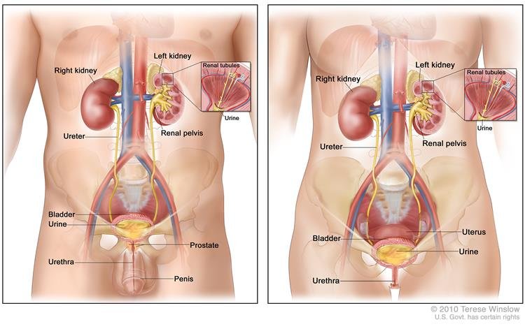
Urinary System: Organs
Male
Female

Slide 3
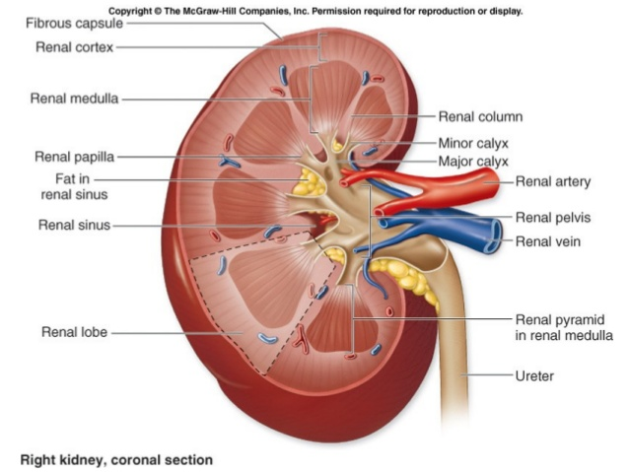
Urinary System: Kidney – Gross Anatomy
Fig. 27.03

Slide 4
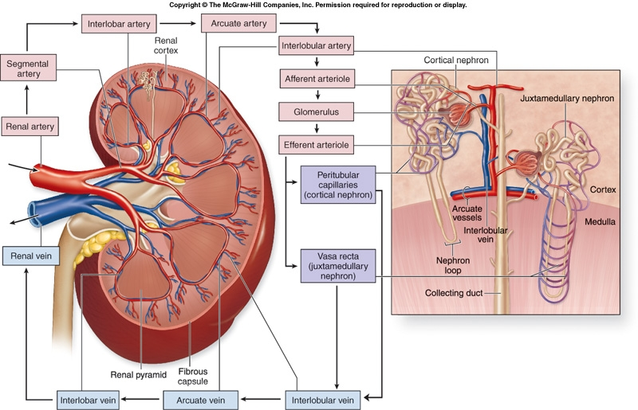
Urinary System: Kidney – Blood Flow
Fig. 27.04

Slide 5
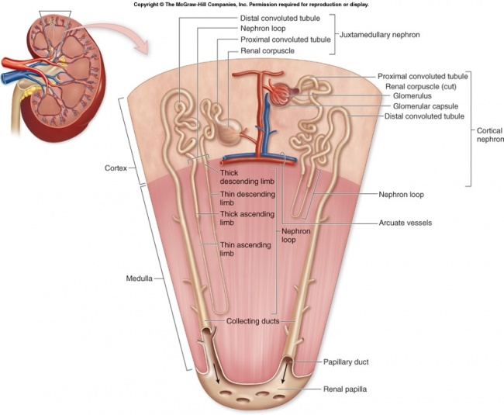
Urinary System: Kidney – Nephron
Fig. 27.05

Slide 6
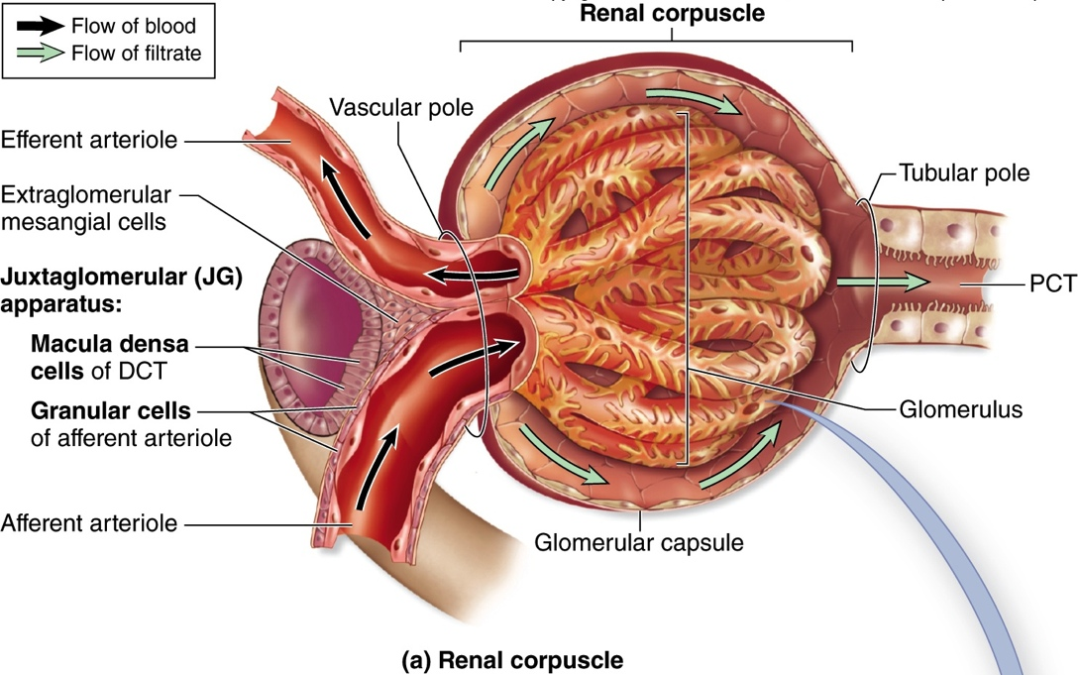
Urinary System: Kidney – Renal Corpuscle
Visceral layer
Capsular space
Parietal layer
Fig. 27.07

Slide 7
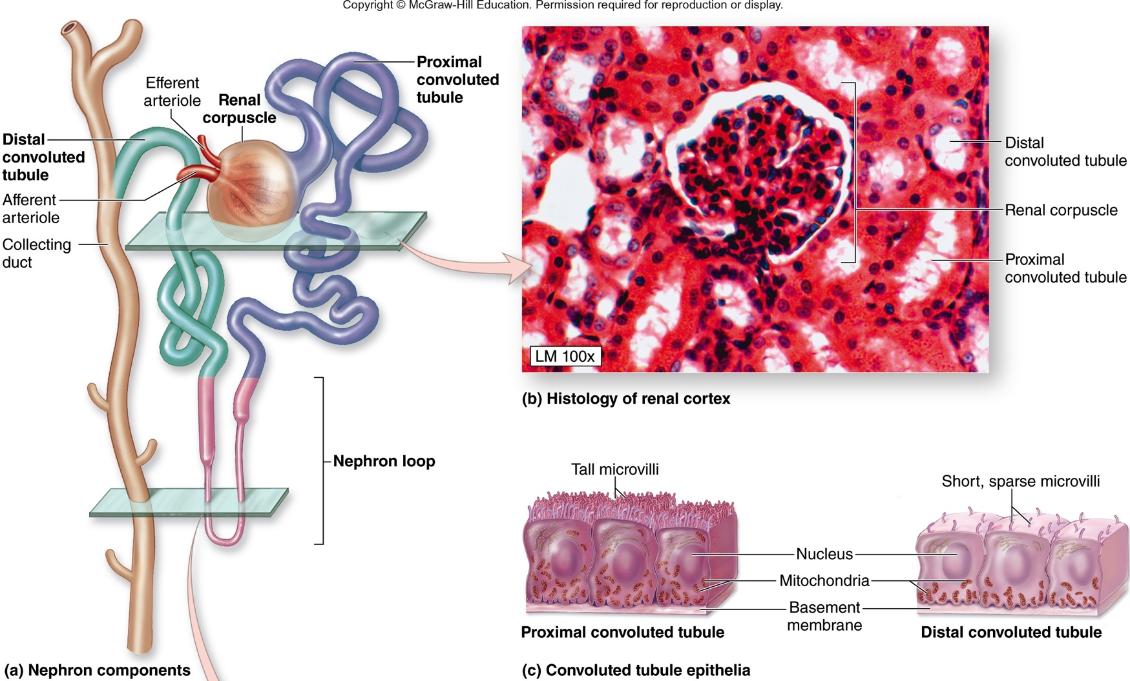
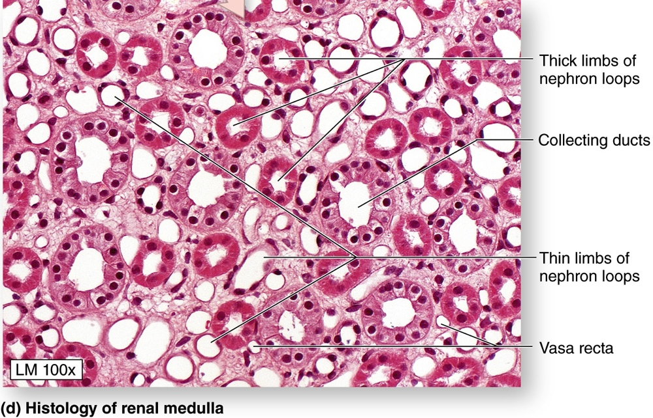
Urinary System: Renal Histology
Fig. 27.08

Slide 8
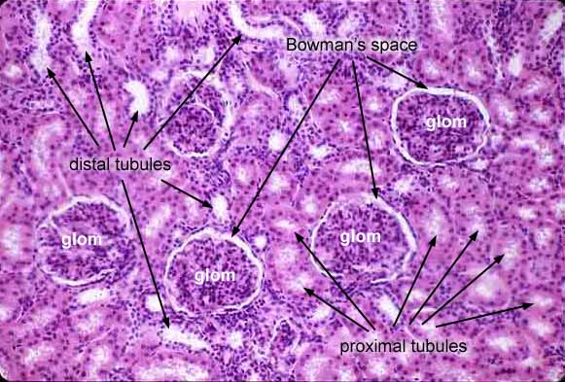
Urinary System: Renal Histology

Slide 9
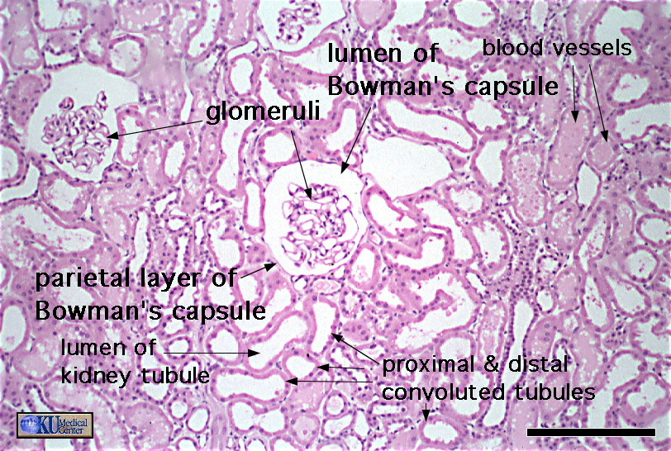
Urinary System: Renal Histology

Slide 10
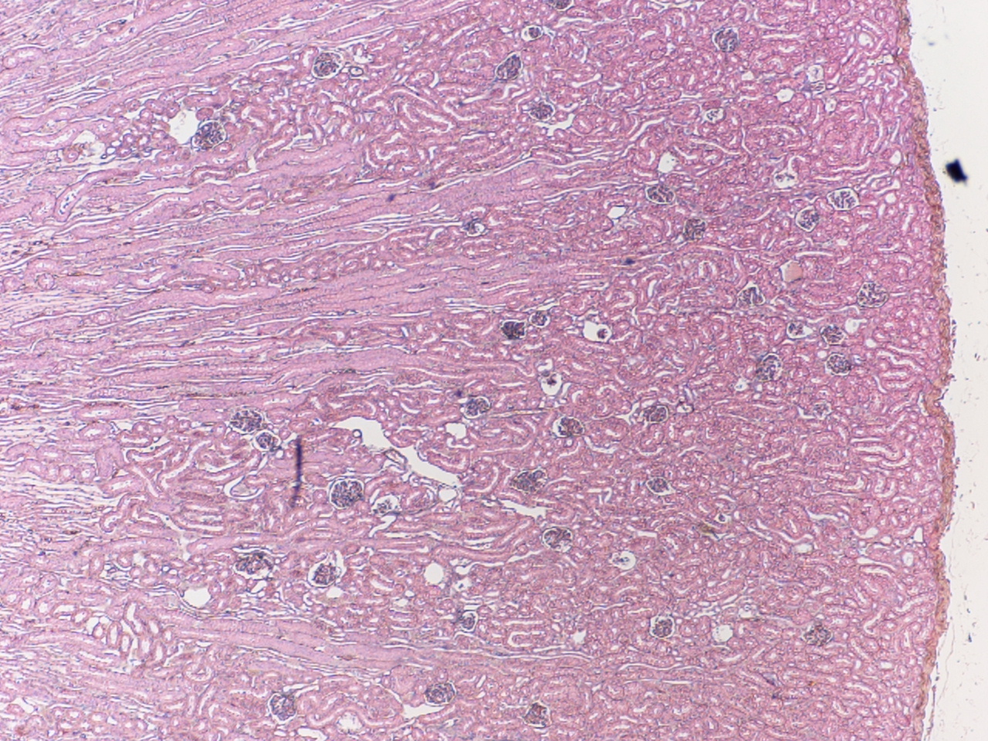
Urinary System: Renal Histology

Slide 11
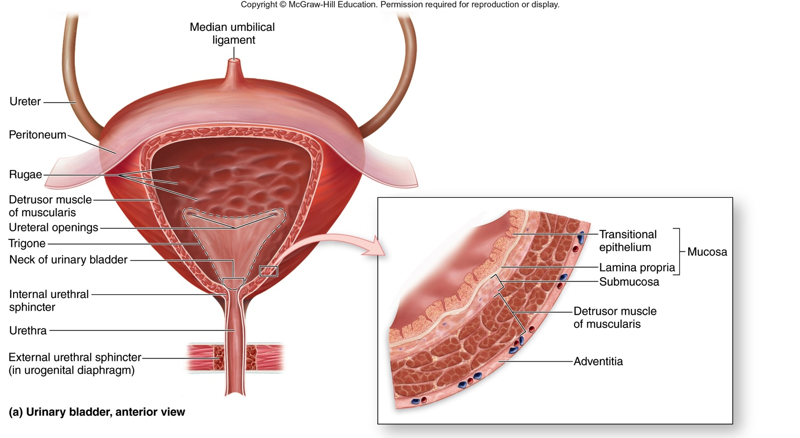
Urinary System: Urinary Bladder
Fig. 27.10

Slide 12
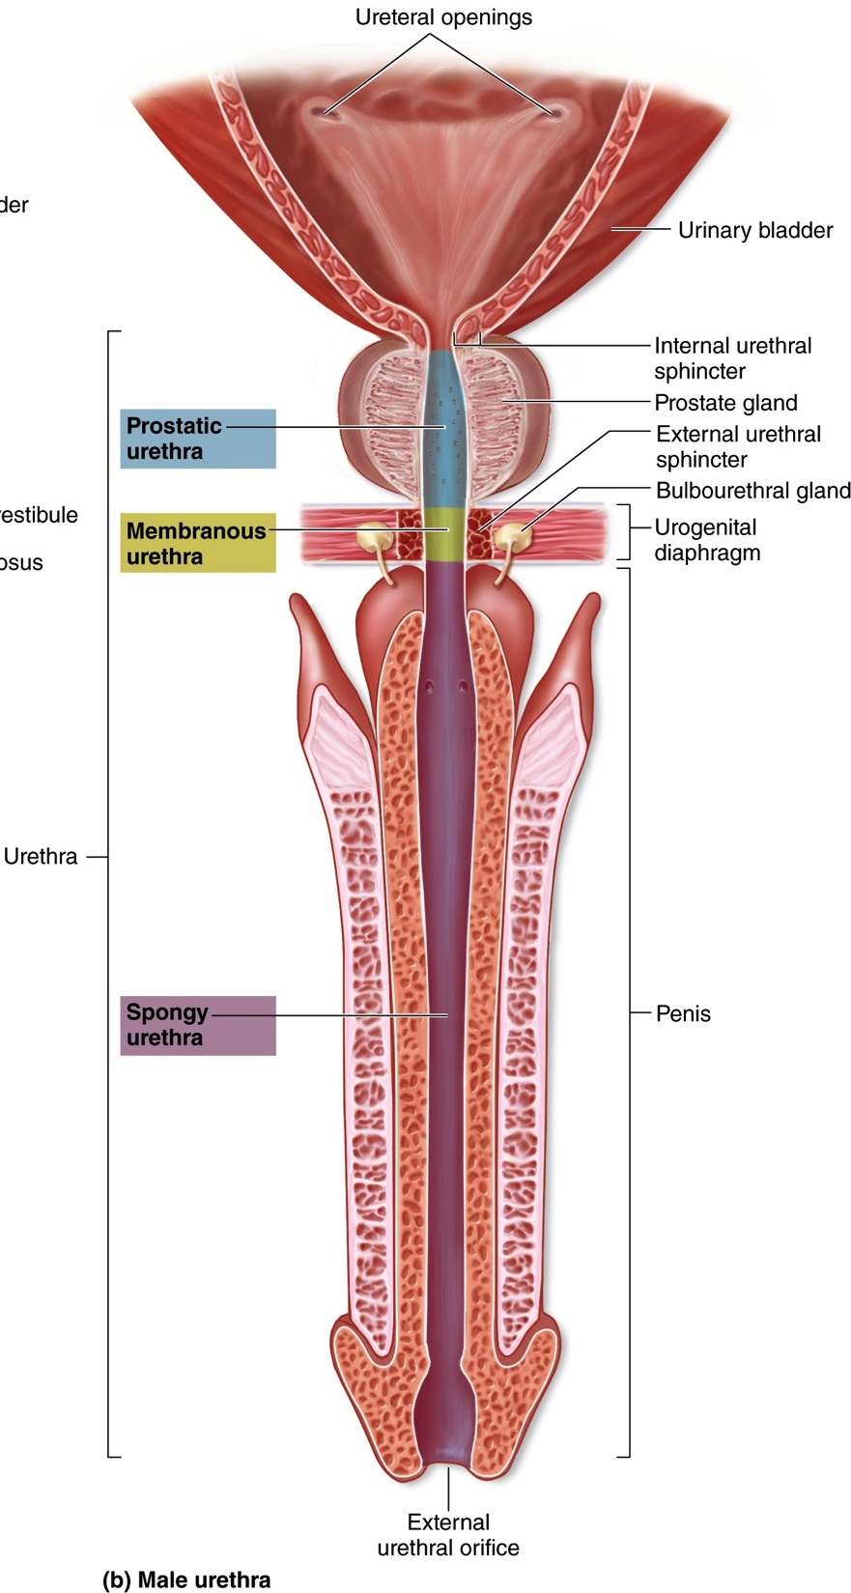
Urinary System: Male Urethra
(about 15 cm in length)
Fig. 27.11

Slide 13
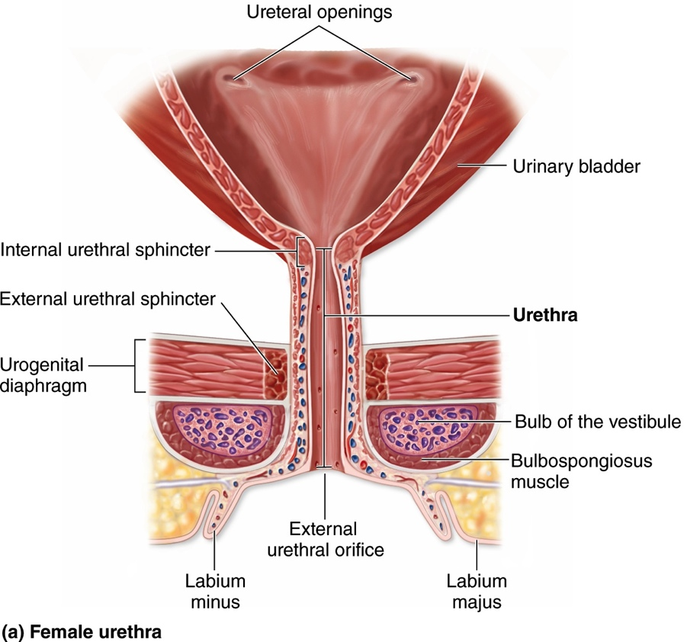
Urinary System: Female Urethra
(about 4 cm in length)
Fig. 27.11

Slide 14
Urinary System: Urine Flow
Glomerular Capsule
Proximal Convoluted Tubule
Collecting Duct
Distal Convoluted Tubule
Nephron Loop
Renal Papilla
Minor Calyx
Major Calyx
Renal Pelvis
Urethra
Urinary Bladder
Ureters

Slide 15
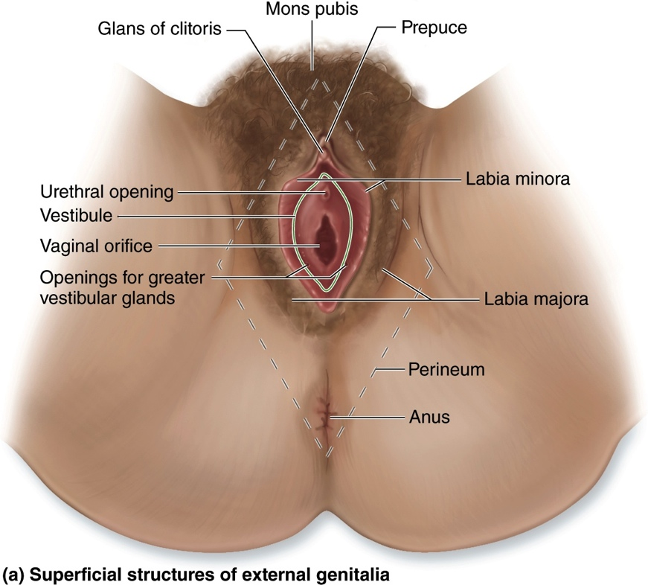
Female Reproductive System: External Structures
Fig. 28.2

Slide 16
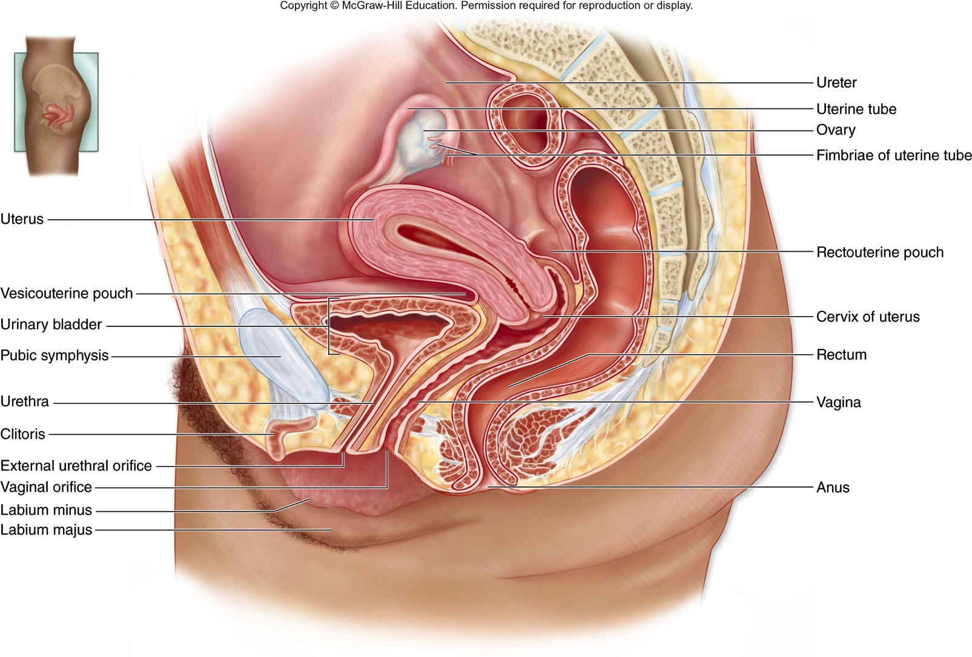
Female Reproductive System: Overview
Fig. 28.2

Slide 17
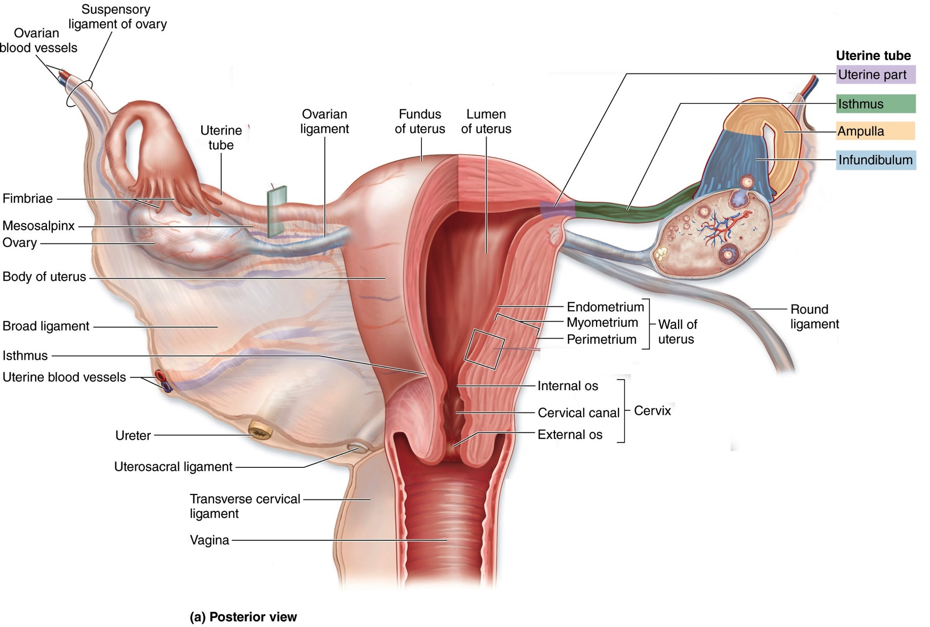
Female Reproductive System: Uterus and Ovaries
Fig. 28.7

Slide 18
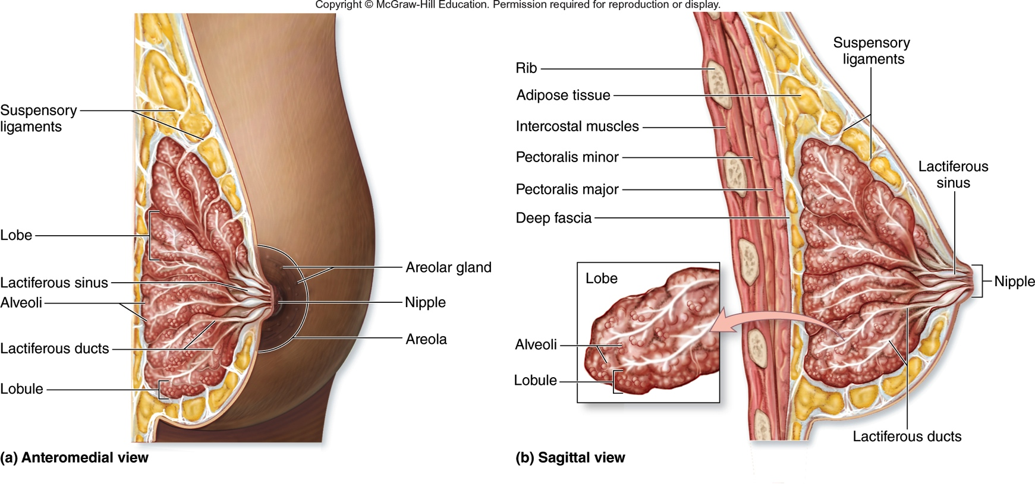
Female Reproductive System: Mammary Glands
Fig. 28.10

Slide 19
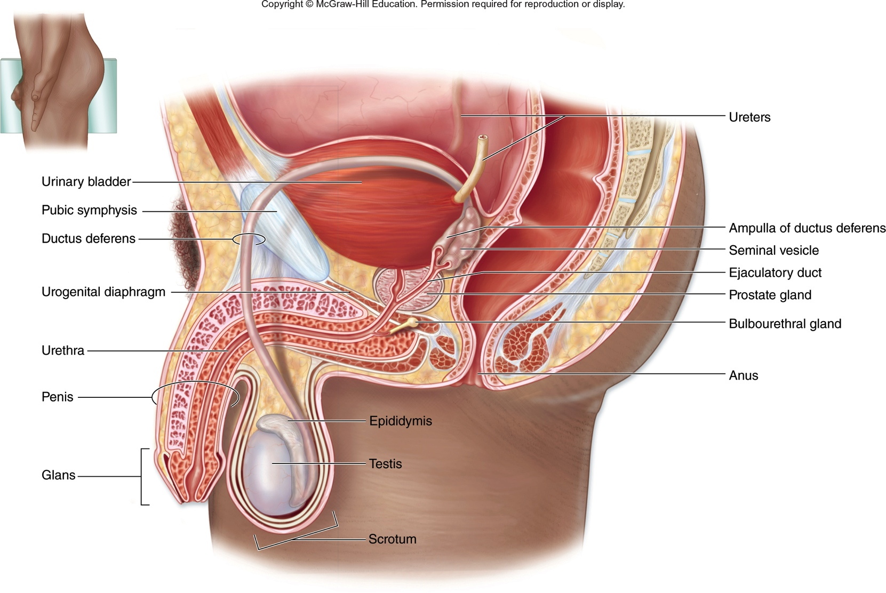
Male Reproductive System: Overview
Fig. 28.11

Slide 20
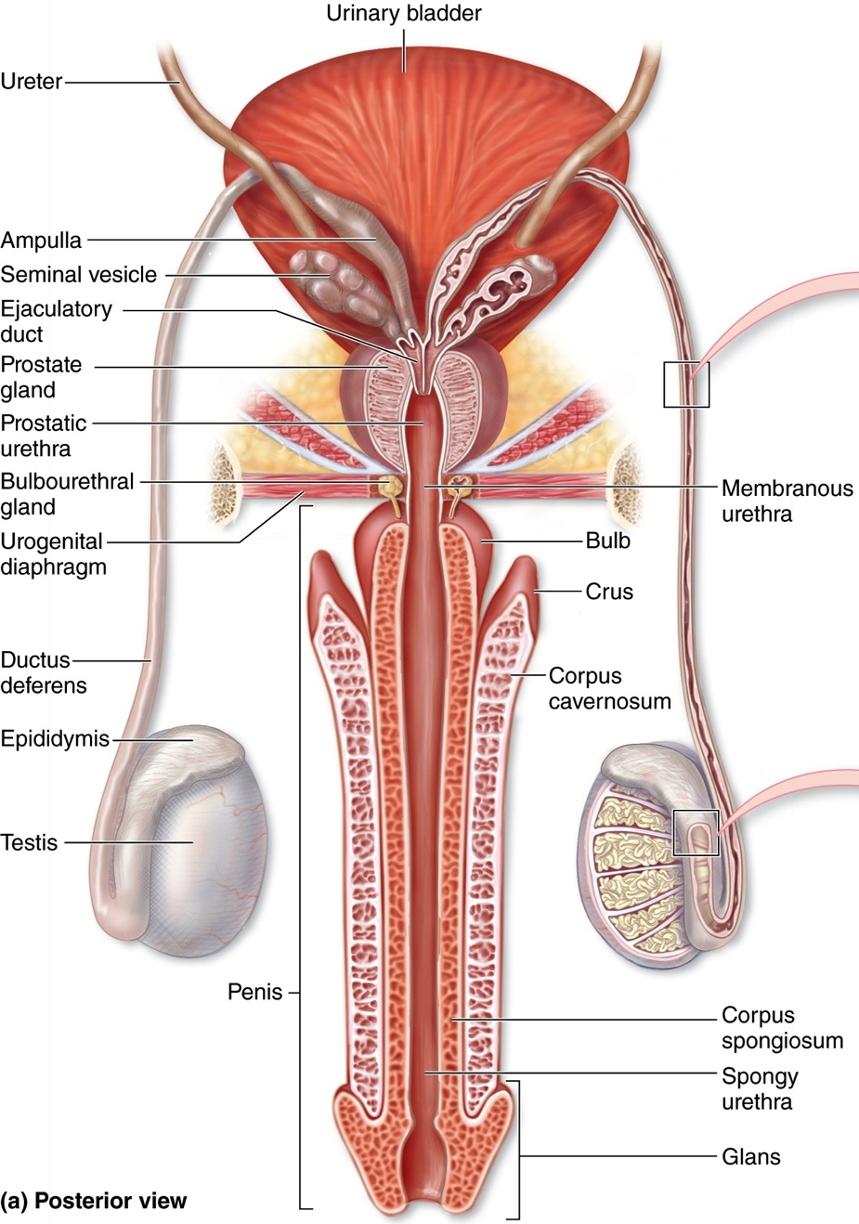
Male Reproductive System: Penis
Body of
Fig. 28.15

Slide 21
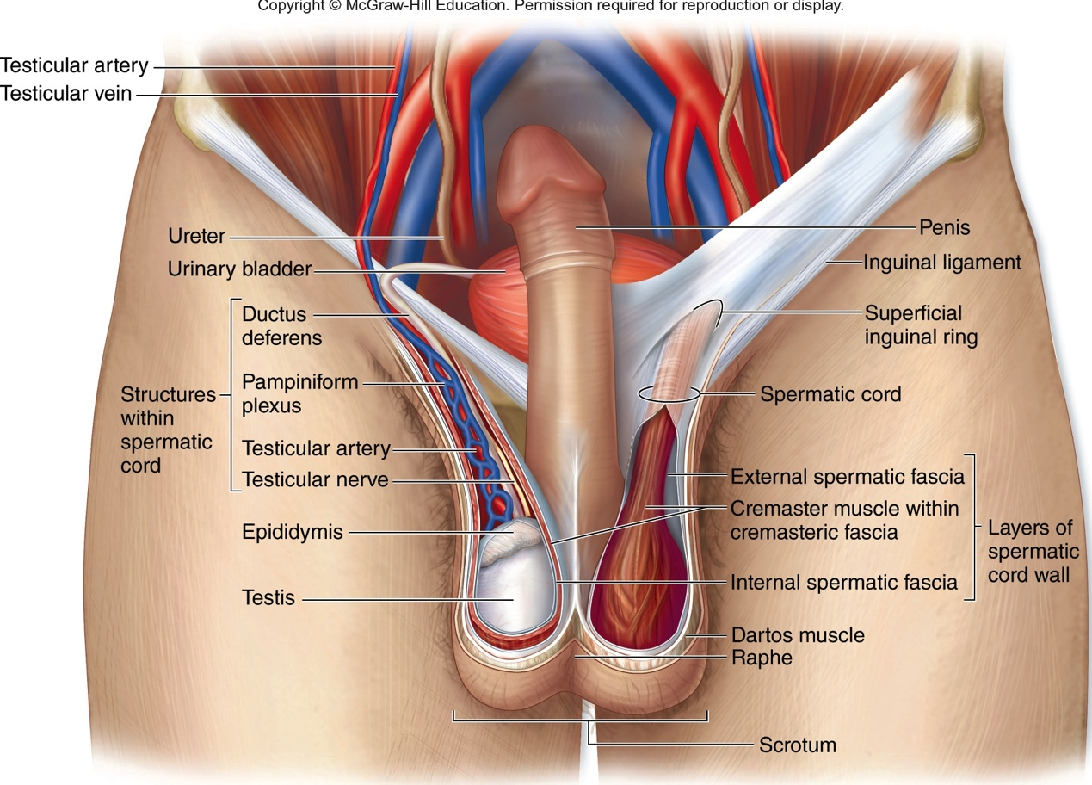
Male Reproductive System: Inguinal Canal
Fig. 28.12

