Slide 1
Activity #9: Blood and Heart
Chapters 21 & 22 – McKinley et al., Human Anatomy, 4e.
Objectives:
Histology: Identify elements in a prepared slide or photo of stained human blood.
Observe and identify the human heart and other major structures in the thoracic cavity of a human cadaver.
Identify structures on models of a human heart.
Perform a dissection on a sheep heart.
Compilation: Lisa Radmall

Slide 2
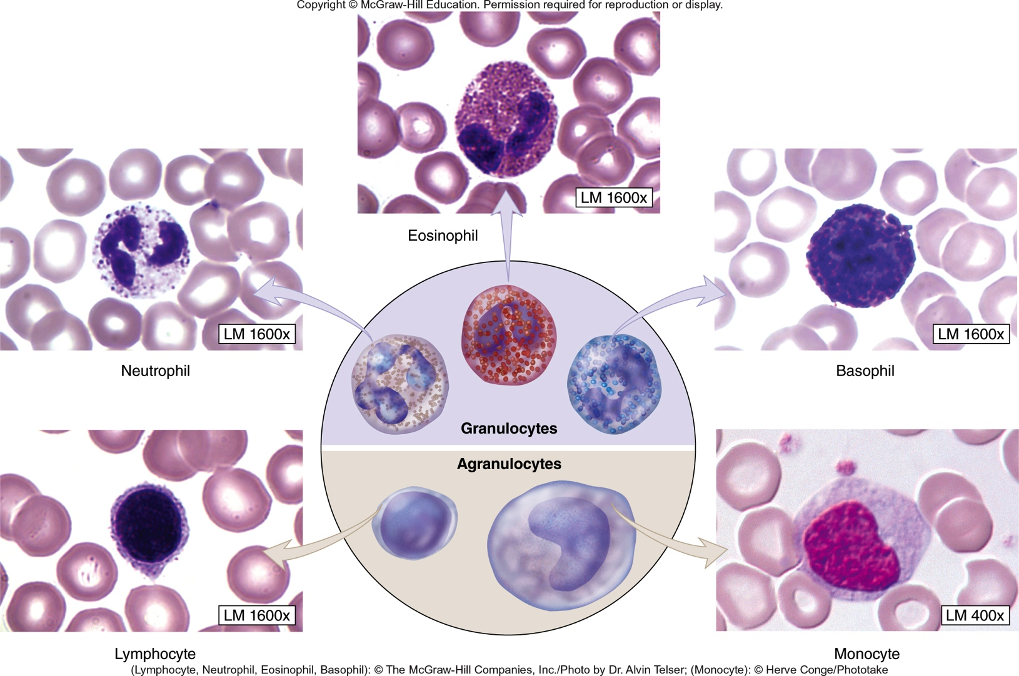
Blood: Histology - Leukocytes
Table 21.2

Slide 3
Blood: Histology - Leukocytes
Neutrophils
Most numerous leukocytes
Segmented nucleus (not round as is typical)
Lymphocytes
Slightly smaller than neutrophils. Second most numerous leukocytes.
Chromatin in nucleus looks clumpy and smudgy.
Monocytes
Large cells with a lot of cytoplasm.
Large nucleus. Usually indented or horseshoe shaped.
Eosinocytes
Large cells. Granules visible in cytoplasm – pink or orange color.
Segmented nucleus, similar to neutrophils.
Basophils
Large, visible granules in cytoplasm – blue/purple in color.
Nucleus usually obscured by large granules
Notes:
http://www.pathologystudent.com/?p=4776

Slide 4
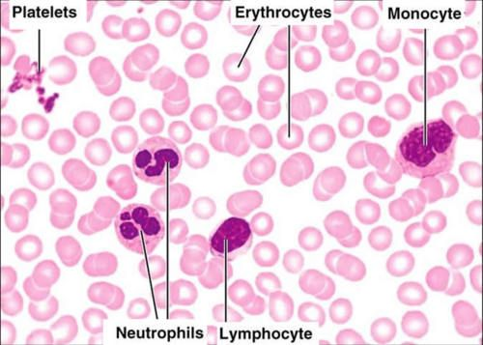
Blood: Histology

Slide 5
Blood: Histology

Slide 6
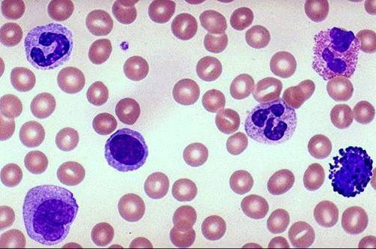
Blood: Histology
3
2
1
5
1
6
7
4

Slide 7
Blood: Histology
Eosinophil
Platelet
Neutrophil
Erythrocyte
(RBC)
Neutrophil
Lymphocyte
Monocyte
Basophil

Slide 8
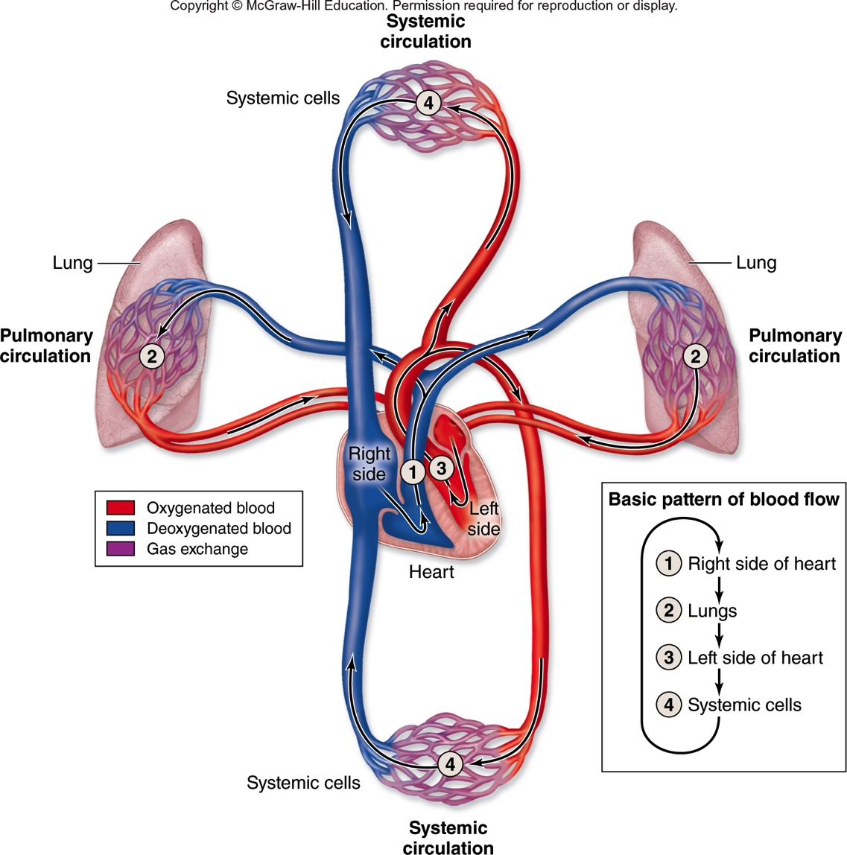
Blood Flow
Fig. 22.1

Slide 9
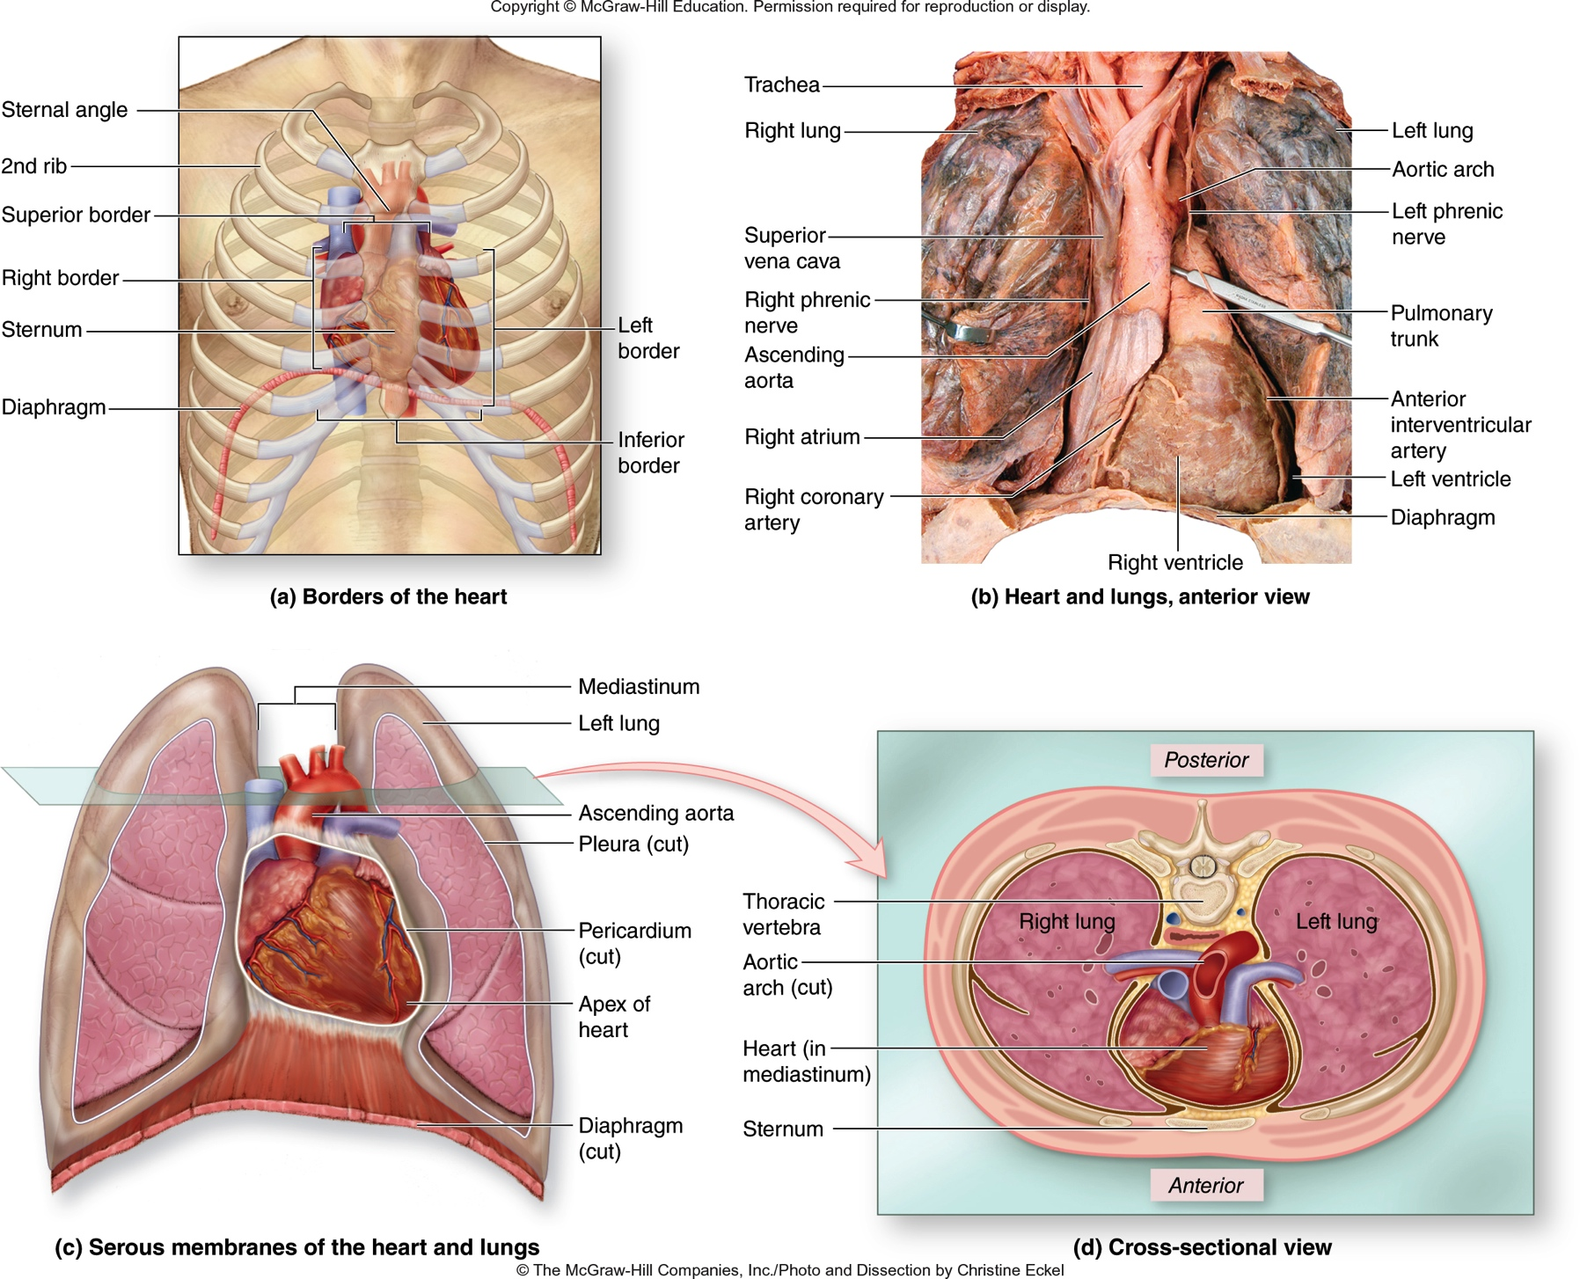
Heart: Position within Thoracic Cavity
Esophagus
(posterior to trachea)

Slide 10
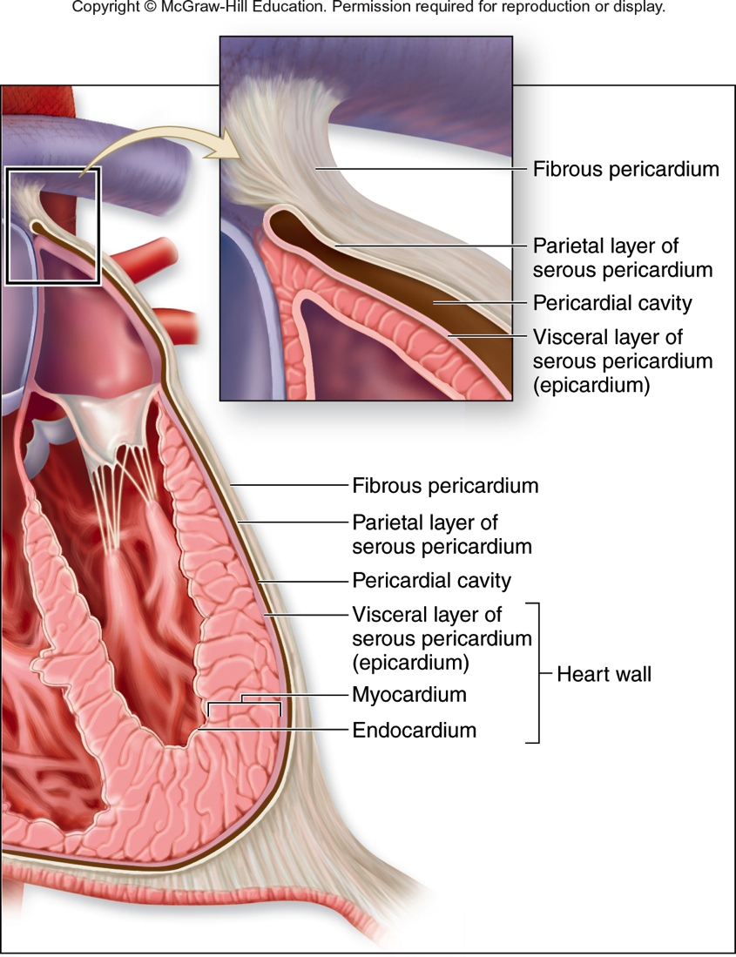
Heart: The Pericardium
Pericardium
Fibrous Pericardium
Tough, dense CT (similar to dura mater)
Serous Pericardium
Secretes pericardial fluid
Parietal layer
Pericardial cavity
Visceral layer (Epicardium)
Myocardium
Middle layer of heart wall, thick
Cardiac muscle tissue
Endocardium
Lines internal surface of heart.
Endothelium & areolar CT
Fig. 22.3
Notes:
Optional slide including myocardium and endocardium

Slide 11
Heart: The Pericardium
Pericardium
Fibrous Pericardium
Tough, dense CT (similar to dura mater)
Attached to diaphragm and base of great vessels
Serous Pericardium
Parietal layer
Lines inner surface of fibrous pericardium
Pericardial cavity
Contains serous fluid
Visceral layer (Epicardium)
Covers surface of heart
Serous membrane & areolar CT
Fig. 22.3
Notes:
Optional slide not including endocarduim and myocarduim with more info on pericardium layers.

Slide 12
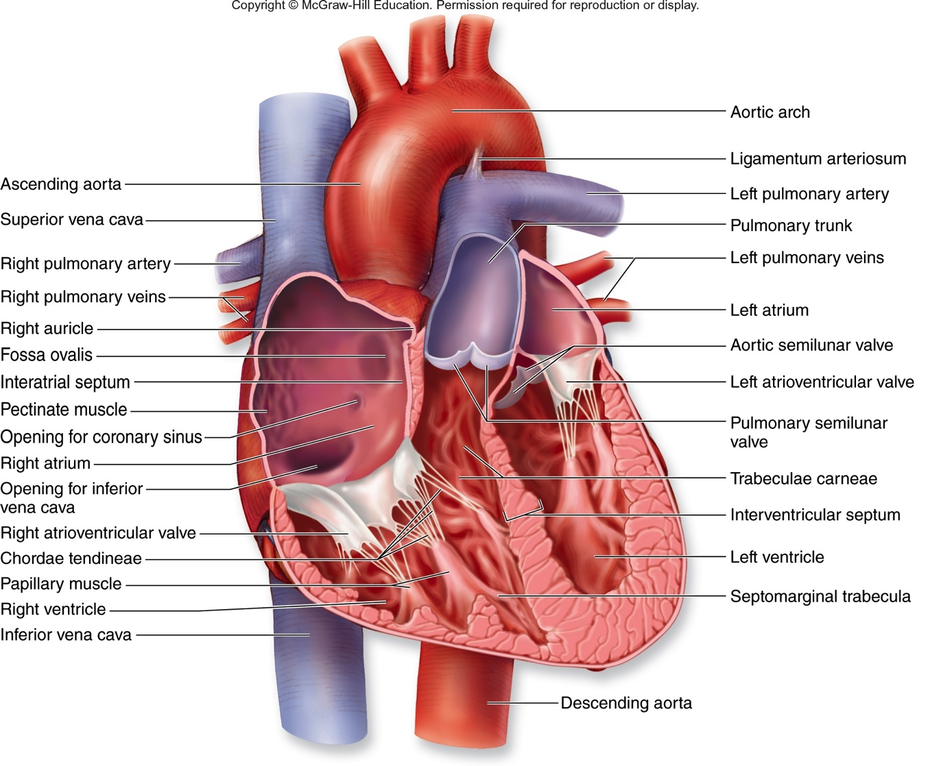
Heart: Structures
Fig. 22.6

Slide 13
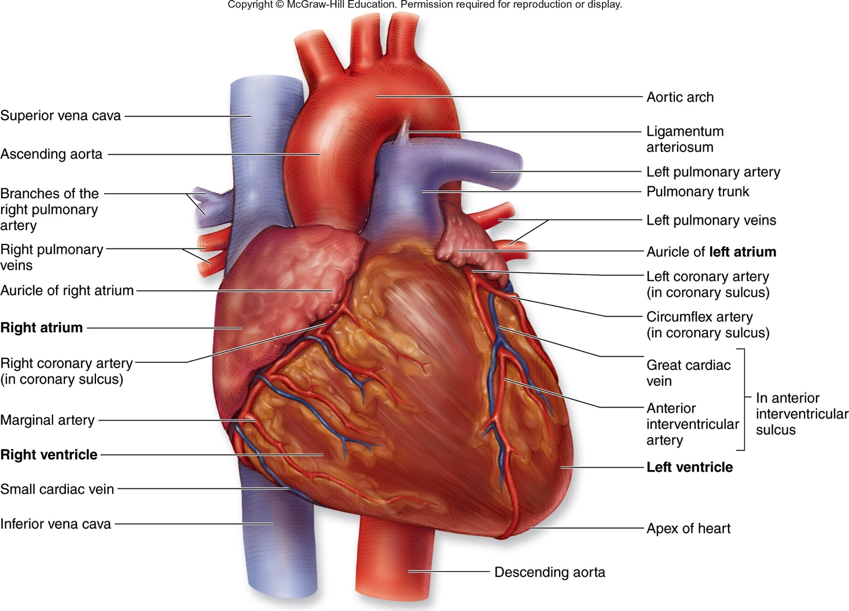
Heart: Structures-Anterior
Fig. 22.5a

Slide 14
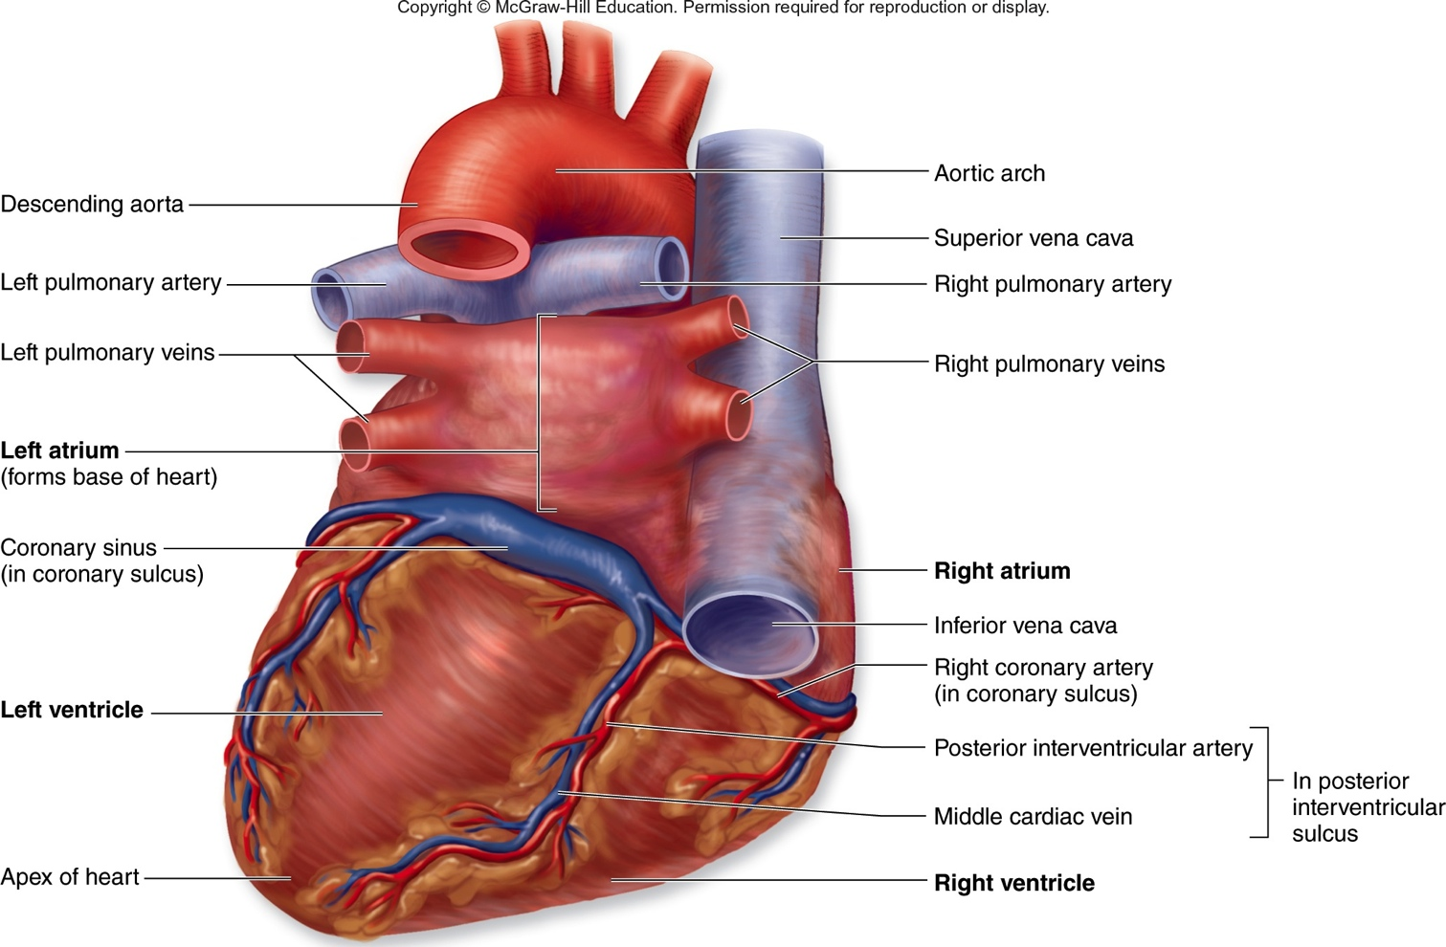
Heart: Structures-Posterior
Contents
Fig. 22.5b

Slide 15
Heart: Internal Structures
Fig. 22.6

Slide 16
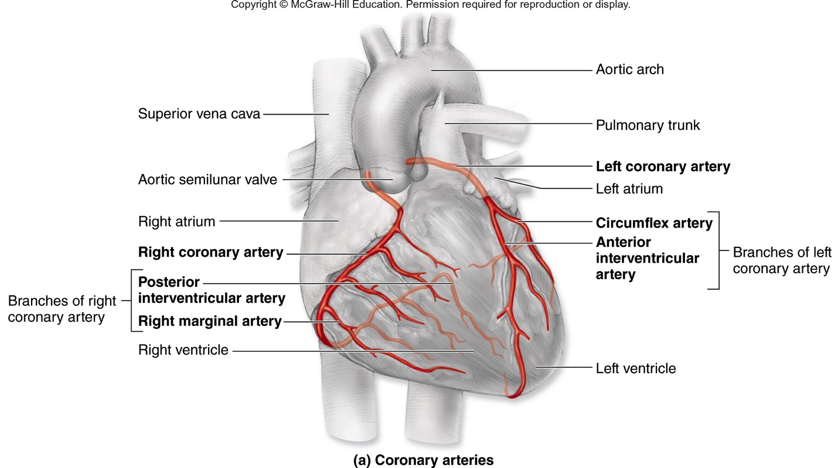
Coronary Circulation: Arterial Supply
The heart wall receives blood from the ascending aorta, and returns blood to the right atrium. It is considered part of systemic circulation.
Fig. 22.9

Slide 17
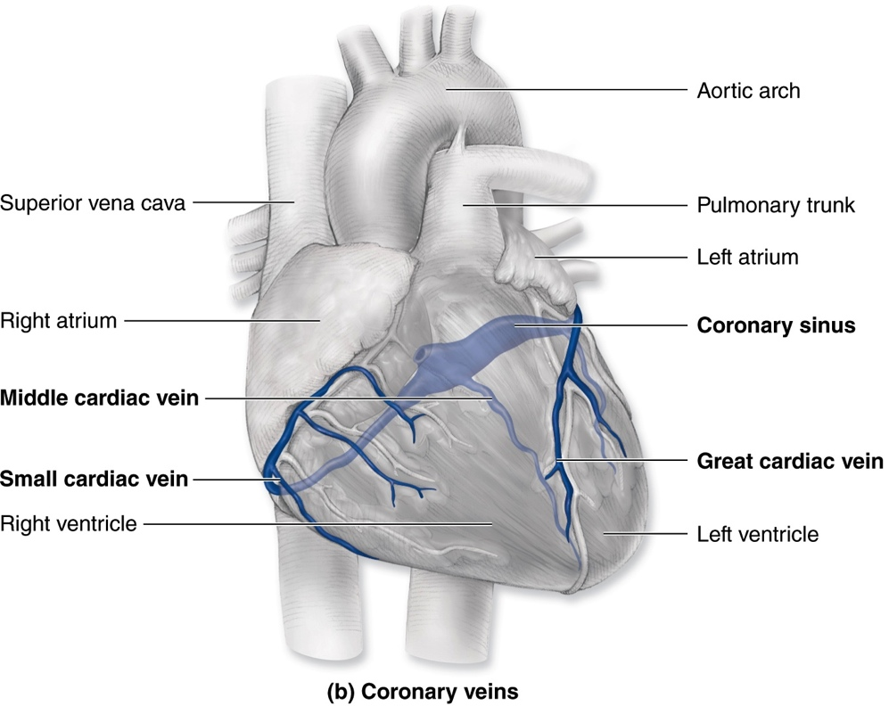
Coronary Circulation: Venous Return
The heart wall receives blood from the ascending aorta, and returns blood to the right atrium. It is considered part of systemic circulation.
Fig. 22.9

Slide 18
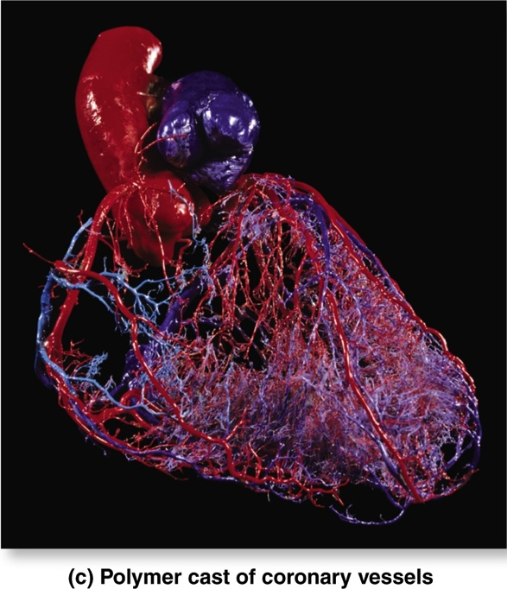
Coronary Circulation: Plastinated Model
Fig. 22.9

Slide 19
Image References
7&8 - http://www.pathologystudent.com/?p=4776
All others – studyblue.com or quizlet.com unless textbook reference noted.

